Slide 1

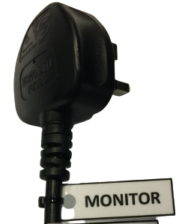
KESERAGAMAN
TAGGING PLAG
Nota:
Cetakan perlu dilaminate
Ditebuk pada sebelah kiri
Diikat dengan cable tie hitam
Kedudukan perlu di sebelah kanan, di bawah kepala plag

Slide 2
MONITOR
MONITOR
MONITOR
MONITOR
MONITOR
MONITOR
MONITOR
MONITOR
MONITOR
MONITOR
MONITOR
MONITOR
MONITOR
MONITOR
MONITOR
MONITOR
MONITOR
MONITOR
MONITOR
MONITOR
MONITOR
MONITOR
MONITOR
MONITOR
CPU
CPU
CPU
CPU
CPU
CPU
CPU
CPU
CPU
CPU
CPU
CPU
CPU
CPU
CPU
CPU
CPU
CPU
CPU
CPU
CPU
CPU
CPU
CPU
CPU
CPU
CPU
CPU
CPU
CPU
CPU
CPU
PRINTER
PRINTER
PRINTER
PRINTER
PRINTER
PRINTER
PRINTER
PRINTER
PRINTER
PRINTER
PRINTER
PRINTER
PRINTER
PRINTER
PRINTER
PRINTER
MONITOR
MONITOR
MONITOR
MONITOR
MONITOR
MONITOR
MONITOR
MONITOR

